Slide 1
Python for Data Fit, Approach and Getting Started
Prepared for DHI
By John Kohnke
July 2017

Slide 2
Agenda
Goals
What is Python?
Why Python for Data?
Why
Implementation Approaches
Scalability, DevOps
Language Basics
Programming with Data
ETL and Pipelines
Analysis
Visualization
Artificial Intelligence / Machine Learning
Materials at: https://github.com/jkohnke/pythonDataIntro
DRAFT – Information is preliminary and subject to change based upon further validation

Slide 3
Goals
Background on Python
Feel for the Python data ecosystem
Provide a feel for the flexibility of Python
Hands on introduction to the basics
Just enough info to be dangerous
DRAFT – Information is preliminary and subject to change based upon further validation
Notes:
a Python programmer can move time-critical functions to extension modules written in languages such as C, or try using PyPy, a just-in-time compiler. Cython is also available, which translates a Python script into C and makes direct C-level API calls into the Python interpreter.
General purpose programming – does everything
Highly intuative
Exception Handling
Forgiveness pricipal
Rather than requiring all desired functionality to be built into the language's core
Small core with large standar libriary
SQL is #1 programming language in some lists, java, javascript, c
About 1/3rd of stackoverflow survied users use it

Slide 4
What is Python?
High-level, general purpose programming
~ Top 5 programming language
Named after Monte
Open Source
Extremely readable & intuitive
Very flexible having a small core with very large set of libraries
DRAFT – Information is preliminary and subject to change based upon further validation
Notes:
a Python programmer can move time-critical functions to extension modules written in languages such as C, or try using PyPy, a just-in-time compiler. Cython is also available, which translates a Python script into C and makes direct C-level API calls into the Python interpreter.
General purpose programming – does everything
Highly intuative
Exception Handling
Forgiveness pricipal
Rather than requiring all desired functionality to be built into the language's core
Small core with large standar libriary
SQL is #1 programming language in some lists, java, javascript, c
About 1/3rd of stackoverflow survied users use it

Slide 5
What is Python?
Written in C
Interpreted, Dynamic typing, Auto memory management
Run everywhere
Supports many programming paradigms
Object-oriented
Imperative
Functional and procedural
Aspect-oriented programming , meta-programming, meta-object & magic methods
Cross compiles to other languages
Heavily in use: YouTube, Dropbox, Google, FB, Netflix, Reddit, NASA, CERN, NSA, included in many OS’s, Raspberry Pi’s main language
www.Python.org
DRAFT – Information is preliminary and subject to change based upon further validation
Notes:
a Python programmer can move time-critical functions to extension modules written in languages such as C, or try using PyPy, a just-in-time compiler. Cython is also available, which translates a Python script into C and makes direct C-level API calls into the Python interpreter.
General purpose programming – does everything
Highly intuative
Exception Handling
Forgiveness pricipal
Rather than requiring all desired functionality to be built into the language's core
Small core with large standar libriary
SQL is #1 programming language in some lists, java, javascript, c
About 1/3rd of stackoverflow survied users use it

Slide 6
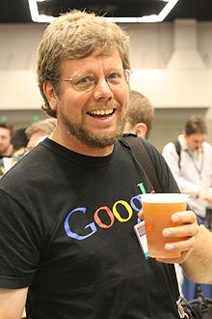
Created by
Guido van Rossum
About the origin of Python, Van Rossum wrote in 1996:
“Over six years ago, in December 1989, I was looking for a "hobby" programming project that would keep me occupied during the week around Christmas. My office ... would be closed, but I had a home computer, and not much else on my hands. I decided to write an interpreter for the new scripting language I had been thinking about lately: a descendant of ABC that would appeal to Unix/C hackers. I chose Python as a working title for the project, being in a slightly irreverent mood (and a big fan of Monty Python's Flying Circus)
Wrote Computer Programming for Everybody while at DARPA
An easy and intuitive language just as powerful as major competitors
Open source, so anyone can contribute to its development
Code that is as understandable as plain English
Suitability for everyday tasks, allowing for short development times
Referred to by the Python community as:
Benevolent Dictator for Life (BDFL)
DRAFT – Information is preliminary and subject to change based upon further validation
Notes:
National Research Institute for Mathematics and Computer Science -- Netherlands
Highly intuative
Exception Handling
Forgiveness pricipal
Rather than requiring all desired functionality to be built into the language's core
Small core with large standar libriary
At dropbox currently, google previously

Slide 7
Zen of Python
Beautiful is better than ugly
Explicit is better than implicit
Simple is better than complex
Complex is better than complicated
Readability counts
Rejects the Perl "there is more than one way to do it" approach,
In favor of "there should be one—and preferably only one—obvious way to do it”
Pythonic – adhering to the above principals
Really strong community
DRAFT – Information is preliminary and subject to change based upon further validation
Notes:
Highly intuative
Exception Handling
Forgiveness pricipal
2 to 3 upgrade was ugly

Slide 8
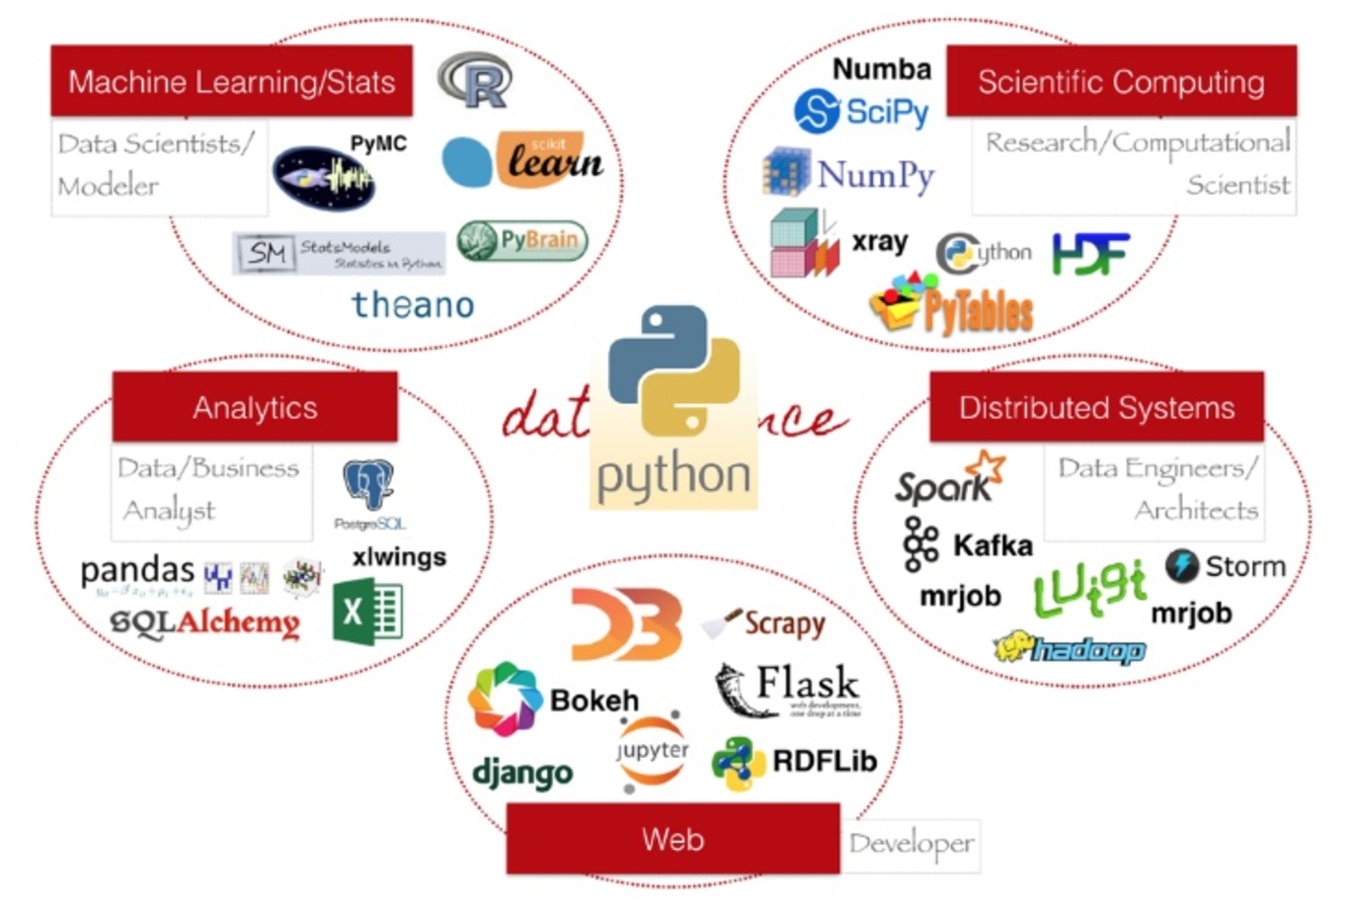
Python Ecosystem
DRAFT – Information is preliminary and subject to change based upon further validation
Notes:
Highly intuative
Exception Handling
Forgiveness pricipal
2 to 3 upgrade was ugly

Slide 9
Why Python for Data?
Can play everywhere
ETL/pipelines
Analysis
Data science and machine learning
Great data functionality & modules
Scalable: Numba, Dash, Blaze, Spark
Lends itself to DevOps and MicroServices
Strong community – PyData
Drawbacks:
It’s a language, not a purpose built toolset
Have to build you own management toolset
It is coding
Scala, Java or C have some advantages
Last major upgrade was ugly
DRAFT – Information is preliminary and subject to change based upon further validation
Notes:
Highly intuative
Exception Handling
Forgiveness pricipal
2 to 3 upgrade was ugly

Slide 10
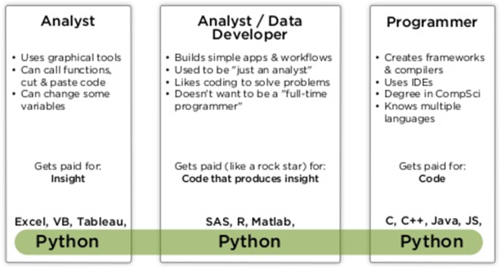
How have I seen it used with data?
Staging layers receiving and preparing data
As traditional ETL, pulling data from Hadoop and relational sources and pushing it back
For data exploration, analysis, data science and AI work
For sharing analysis work
As production implementations of AI models
As the stream processing microservices layers surrounding Kafka
DRAFT – Information is preliminary and subject to change based upon further validation
Notes:
Highly intuative
Exception Handling
Forgiveness pricipal
2 to 3 upgrade was ugly

Slide 11
Coding Basics
Development tools
CLI
Sublime, Wing, vi, etc.
iPython & Jupyter Notebooks juypter
is an open-source web application that allows you to create and share documents that contain live code, equations, visualizations and explanatory text.
Run by typing “jupyter notebook” on the command line
Running code
Within a notebook
Command line python <program name>
DRAFT – Information is preliminary and subject to change based upon further validation
Notes:
Highly intuative
Exception Handling
Forgiveness pricipal
2 to 3 upgrade was ugly

Slide 12
Coding Basics
Modules
https://pypi.python.org/pypi
100,000+ packages
Pip and wheel installs
Normal: pip install <module_name>
Wheels: pip install <package.whl>
Misc
Tabs != Spaces
Single or double quotes work identically
Zero based indexing
Order of operations, mimics math
Exception handling and forgiveness principal
DRAFT – Information is preliminary and subject to change based upon further validation
Notes:
Highly intuative
Exception Handling
Forgiveness pricipal
2 to 3 upgrade was ugly

Slide 13
Coding Basics
Statements & Flow Control
Assignment ‘=‘, names are bound to objects
if, elif, else
for, while
try, except, finally
def
assert
import
print, type
input
Operators and Operands
=, +, -, *, %, /, **
Comparison: ==, !=, >, <, >=, <=, is, is not
None is the unassigned value
Logical operators
Short circuit evaluation
DRAFT – Information is preliminary and subject to change based upon further validation
Notes:
Highly intuative
Exception Handling
Forgiveness pricipal
2 to 3 upgrade was ugly

Slide 14
Coding Basics
Data Types
Dynamic but strongly typed
Don’t need to assign types initially
But need to cast frequently
Strings
Lists [1, 2, 3], mutable, unkeyed
Tuples (1, 2, 3), unmutable, unkeyed
Tuple operations : x, y = y, x
Dictionaries {'key1': 1.0, 3: False}, mutable key value pairs
Array Indexing & Slicing
a[key], a[start:stop]
Negative indexes are relative to the end
DRAFT – Information is preliminary and subject to change based upon further validation
Notes:
Highly intuative
Exception Handling
Forgiveness pricipal
2 to 3 upgrade was ugly

Slide 15
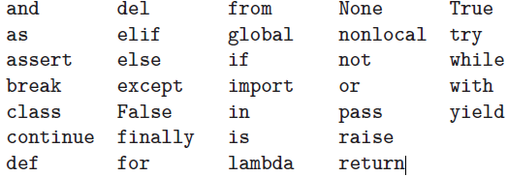
Coding Basics
Reserved Words
DRAFT – Information is preliminary and subject to change based upon further validation
Notes:
Highly intuative
Exception Handling
Forgiveness pricipal
2 to 3 upgrade was ugly

Slide 16
Pandas
Notes
Library for data manipulation and analysis
Created by an MIT quant, 3 years out of school
Awesome in memory processing
Need other solutions when exceeding memory
http://pandas.pydata.org
Coding Notes
A dataframe is the main structure, very table like
Functions exist for working directly with .xlsx and sql
DRAFT – Information is preliminary and subject to change based upon further validation
Notes:
Highly intuative
Exception Handling
Forgiveness pricipal
2 to 3 upgrade was ugly

Slide 17
Visualizations
Matplotlib
Built in visualizations
https://pandas.pydata.org/pandas-docs/stable/visualization.html
Not quite as pretty as other options
Bokeh
http://bokeh.pydata.org
Additional, prettier visualization module
DRAFT – Information is preliminary and subject to change based upon further validation
Notes:
Highly intuative
Exception Handling
Forgiveness pricipal
2 to 3 upgrade was ugly

Slide 18

Machine Learning
Scikit Learn
Simple and efficient tools for data mining and data analysis
http://scikit-learn.org/stable/
DRAFT – Information is preliminary and subject to change based upon further validation
Notes:
Highly intuative
Exception Handling
Forgiveness pricipal
2 to 3 upgrade was ugly

